Slide 1
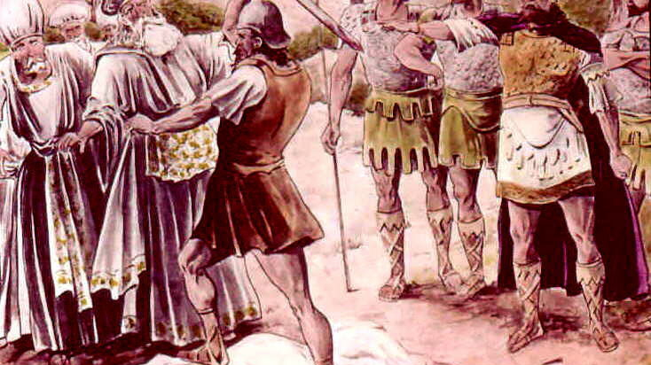
The Rule of Antichrist
1 Samuel 22

Slide 2
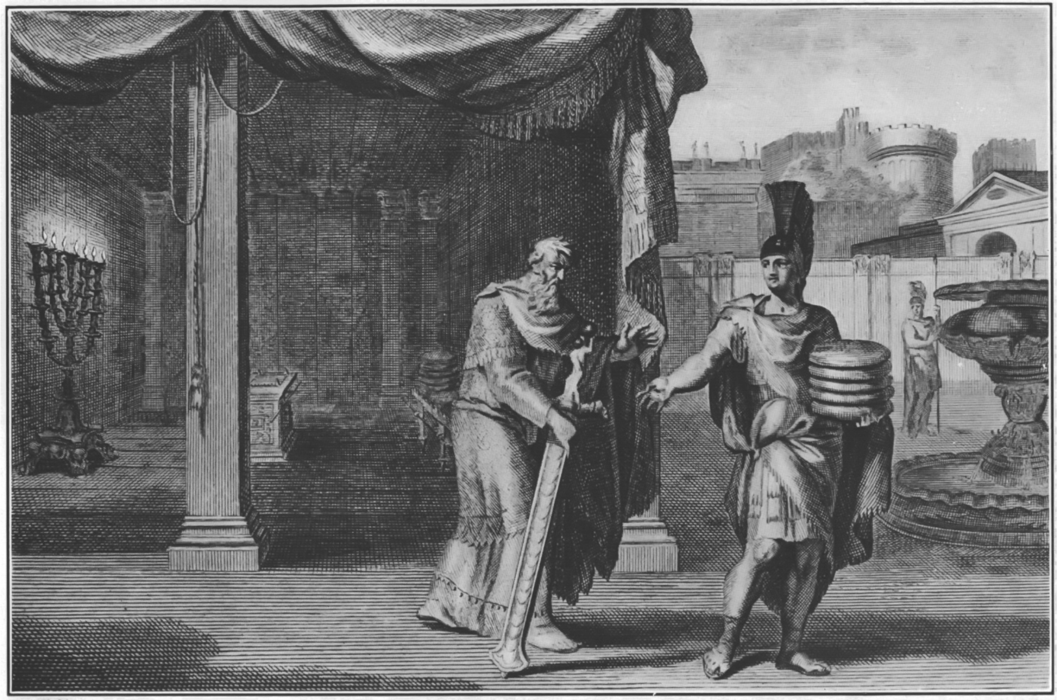

Slide 3
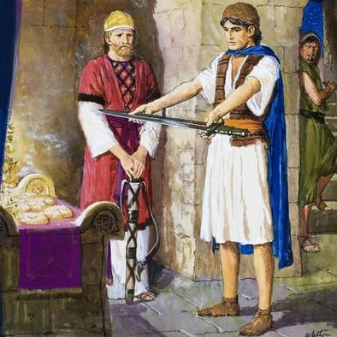
God is enough!
We need the Word of God to live the life God has called us to!

Slide 4
2 Peter 1:1-4 Simon Peter, a servant and an apostle of Jesus Christ, to them that have obtained like precious faith with us through the righteousness of God and our Saviour Jesus Christ: 2 Grace and peace be multiplied unto you through the knowledge of God, and of Jesus our Lord, 3 According as his divine power hath given unto us all things that pertain unto life and godliness, through the knowledge of him that hath called us to glory and virtue: 4 Whereby are given unto us exceeding great and precious promises: that by these ye might be partakers of the divine nature, having escaped the corruption that is in the world through lust.

Slide 5
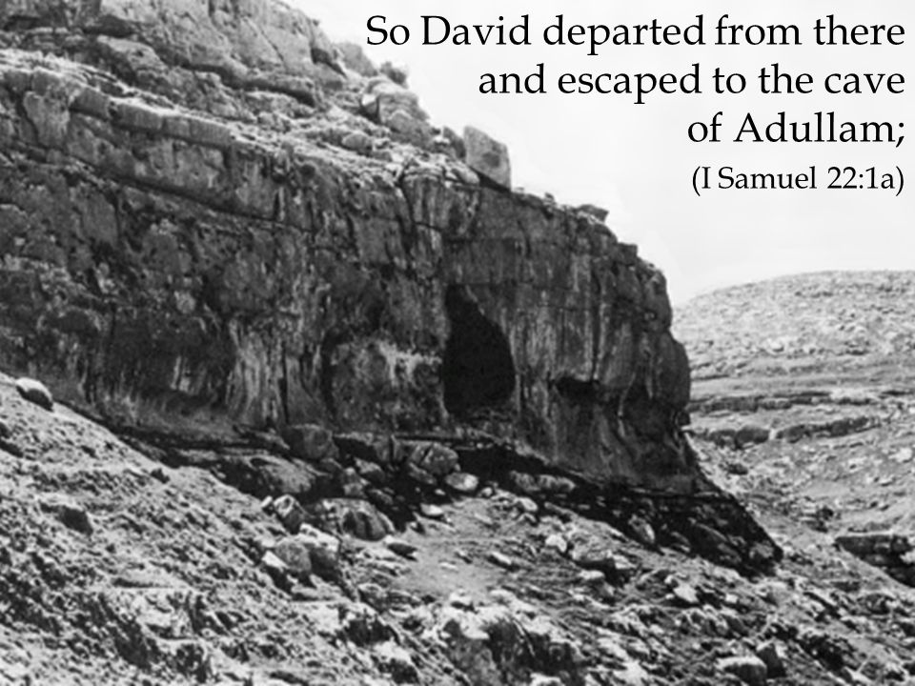



Slide 6
Psalm 142:1-7 I cried unto the LORD with my voice; with my voice unto the LORD did I make my supplication. 2 I poured out my complaint before him; I shewed before him my trouble. 3 When my spirit was overwhelmed within me, then thou knewest my path. In the way wherein I walked have they privily laid a snare for me. 4 I looked on my right hand, and beheld, but there was no man that would know me: refuge failed me; no man cared for my soul. 5 I cried unto thee, O LORD: I said, Thou art my refuge and my portion in the land of the living. 6 Attend unto my cry; for I am brought very low: deliver me from my persecutors; for they are stronger than I. 7 Bring my soul out of prison, that I may praise thy name: the righteous shall compass me about; for thou shalt deal bountifully with me.

Slide 7
2 Chronicles 7:14 If my people, which are called by my name, shall humble themselves, and pray, and seek my face, and turn from their wicked ways; then will I hear from heaven, and will forgive their sin, and will heal their land.

Slide 8
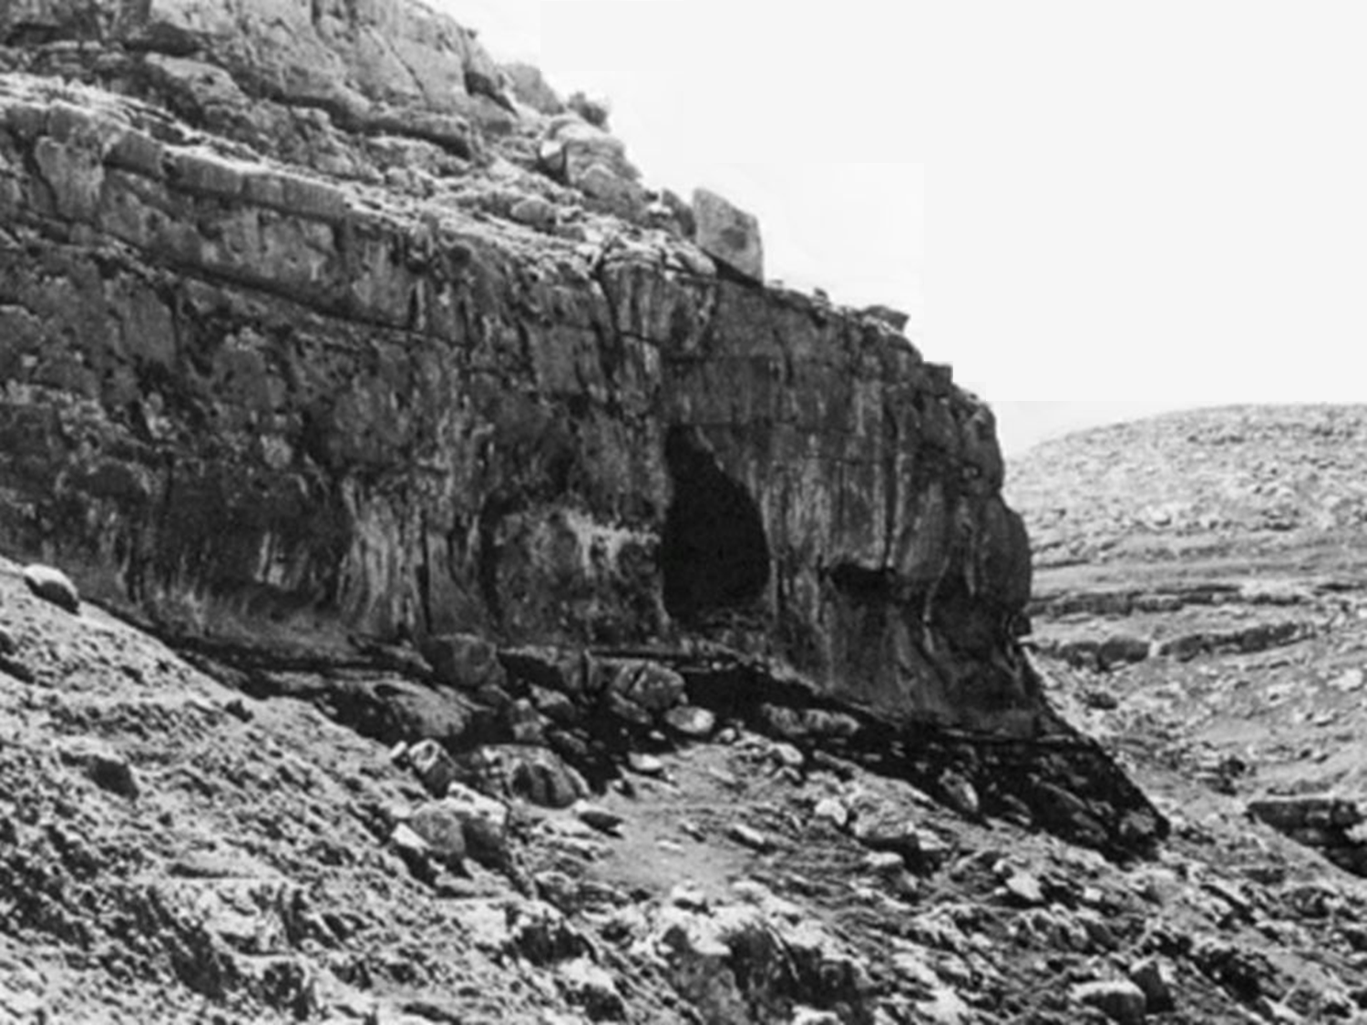
Picture: Powerful motivators that draw people to Christ.
Brethren
Distress

Slide 9
Psalm 25:16-18 Turn thee unto me, and have mercy upon me; for I am desolate and afflicted. 17 The troubles of my heart are enlarged: O bring thou me out of my distresses. 18 Look upon mine affliction and my pain; and forgive all my sins.

Slide 10
Picture: Powerful motivators that draw people to Christ.
Brethren
Distress
Debt

Slide 11
Romans 8:12 Therefore, brethren, we are debtors, not to the flesh, to live after the flesh.
Romans 1:14-16 14 I am debtor both to the Greeks, and to the Barbarians; both to the wise, and to the unwise. 15 So, as much as in me is, I am ready to preach the gospel to you that are at Rome also. 16 For I am not ashamed of the gospel of Christ: for it is the power of God unto salvation to every one that believeth; to the Jew first, and also to the Greek.

Slide 12
Acts 20:25-27 25 And now, behold, I know that ye all, among whom I have gone preaching the kingdom of God, shall see my face no more. 26 Wherefore I take you to record this day, that I am pure from the blood of all men. 27 For I have not shunned to declare unto you all the counsel of God.

Slide 13
Picture: Powerful motivators that draw people to Christ.
Brethren
Distress
Debt
Discontent

Slide 14
Ecclesiastes 12:13 Let us hear the conclusion of the whole matter: Fear God, and keep his commandments: for this is the whole duty of man.

Slide 15
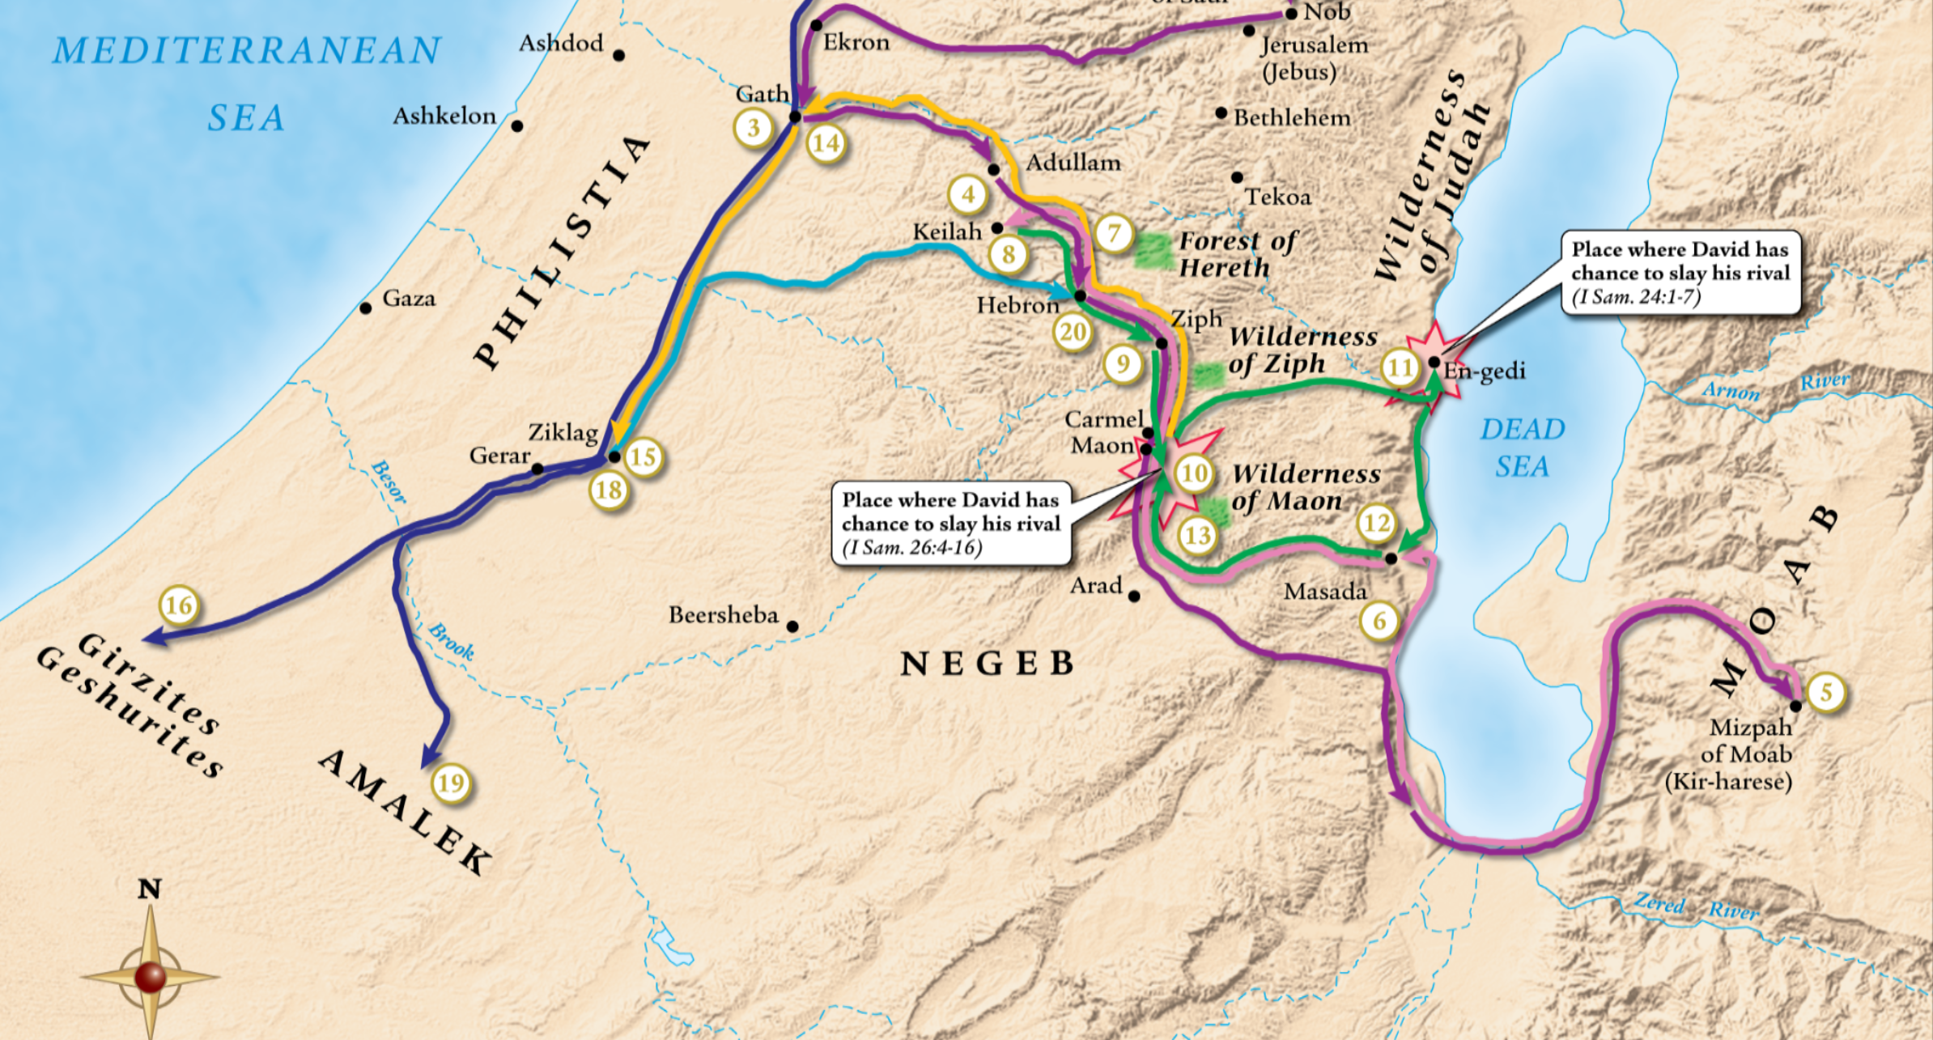

Slide 16
Ruth 4:21-22 And Salmon begat Boaz, and Boaz begat Obed, 22 And Obed begat Jesse, and Jesse begat David.

Slide 17
Take care of your parents when they cannot take care of themselves!

Slide 18
Exodus 20:12 Honour thy father and thy mother: that thy days may be long upon the land which the LORD thy God giveth thee.
Proverbs 23:22 Hearken unto thy father that begat thee, and despise not thy mother when she is old.
Leviticus 19:32 Thou shalt rise up before the hoary head, and honour the face of the old man, and fear thy God: I am the LORD.
1 Timothy 5:4 But if any widow have children or nephews, let them learn first to shew piety at home, and to requite their parents: for that is good and acceptable before God.

Slide 19
Move forward in faith.
Gad is directive!

Slide 20
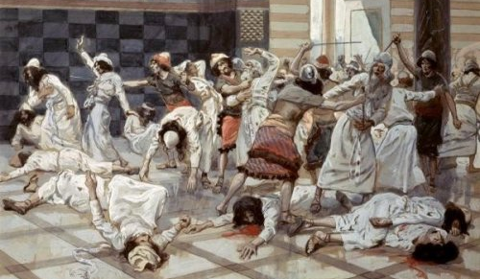
Saul: a type of antichrist.
Saul is back under his tree.
1 Samuel 14:2
He is the “accuser of our brethren” Revelation 12:10
Doeg pictures the false prophet.
Rev 13:11-18

Slide 21
Exodus 20:13 Thou shalt not kill.
Revelation 13:15 And he had power to give life unto the image of the beast, that the image of the beast should both speak, and cause that as many as would not worship the image of the beast should be killed.

Slide 22
2 Peter 2:20 For if after they have escaped the pollutions of the world through the knowledge of the Lord and Saviour Jesus Christ, they are again entangled therein, and overcome, the latter end is worse with them than the beginning.
Luke 11:24-26 24 When the unclean spirit is gone out of a man, he walketh through dry places, seeking rest; and finding none, he saith, I will return unto my house whence I came out. 25 And when he cometh, he findeth it swept and garnished. 26 Then goeth he, and taketh to him seven other spirits more wicked than himself; and they enter in, and dwell there: and the last state of that man is worse than the first.

Slide 23
1 John 3:15 Whosoever hateth his brother is a murderer: and ye know that no murderer hath eternal life abiding in him.
John 8:44 Ye are of your father the devil, and the lusts of your father ye will do. He was a murderer from the beginning, and abode not in the truth, because there is no truth in him. When he speaketh a lie, he speaketh of his own: for he is a liar, and the father of it.

Slide 24
2 Thessalonians 2:4 Who opposeth and exalteth himself above all that is called God, or that is worshipped; so that he as God sitteth in the temple of God, shewing himself that he is God.

Slide 25
Picture: Safe with Jesus.
Satan sought the life of Christ!
Revelation 12:4 And his tail drew the third part of the stars of heaven, and did cast them to the earth: and the dragon stood before the woman which was ready to be delivered, for to devour her child as soon as it was born.
Satan seeks your life too!
1 Peter 5:8 Be sober, be vigilant; because your adversary the devil, as a roaring lion, walketh about, seeking whom he may devour:

Slide 26
The Rule of Antichrist
1 Samuel 22

